Slide 1
Review of Siamese Neural Networks for One-shot Image Recognition
#Group-6 (CSE713)
Presentor: Prattoy Majumder (22266019)
ST-1: Abid Hossain
ST-2: Ehsanur Rahman Rhythm
RA: MD Humaion Kabir Mehedi

Slide 2
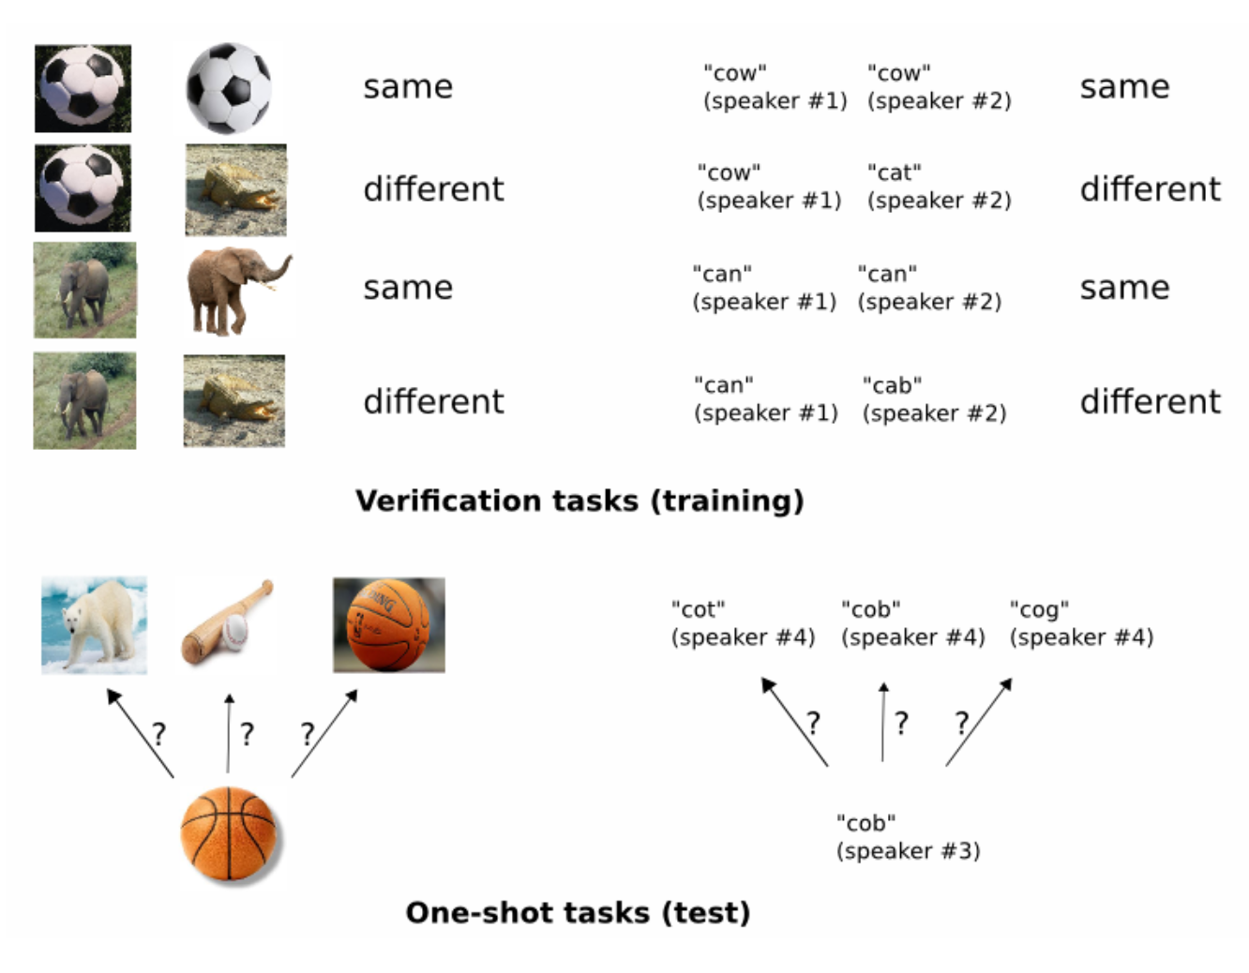
One-shot Image Recognition Challenge
Traditional models use extensive data
One shot uses minimal training data
Offers a promising solution for one-shot image recognition tasks

Slide 3
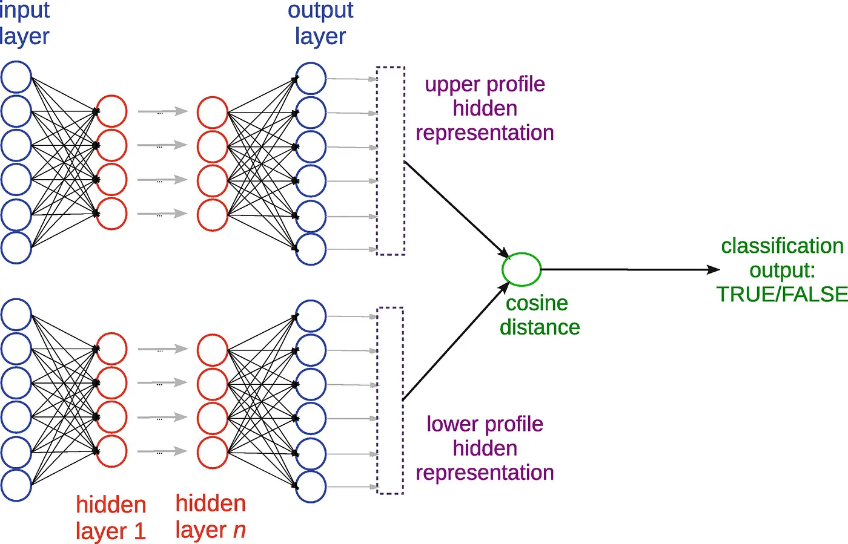
Siamese Network Architecture

Slide 4
Learning
Loss function
Optimization
Weight initialization
Learning schedule
Hyperparameter optimization
Affline distortions

Slide 5
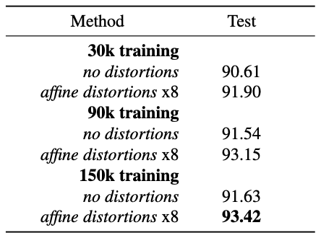
Experiments
Dataset
Evaluation protocol
Siamese network architecture
One-shot image recognition performance
Comparison with other methods
Experimental results
Analysis and results

Slide 6
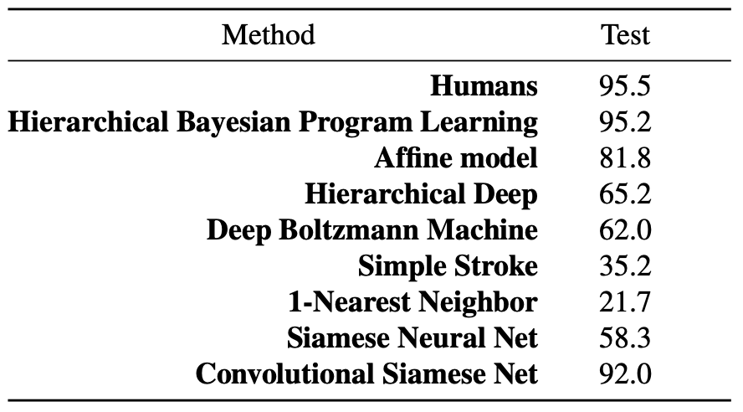
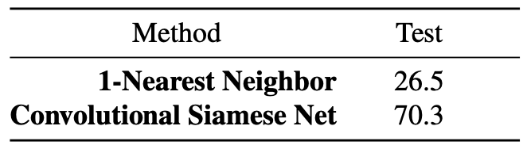
Accuracy on Omniglot verification task (siamese convo- lutional neural net)

Slide 7
Future Directions
Improved efficiency and scalability
Investigation of various network architectures
Applying it to more complex and challenging one-shot tasks

Slide 8
Thank You!

